Slide 1
SMART WATER FOUNTAINS

Slide 2
Introduction
Water fountains have become very popular over the last irrigation facilities that uses sensor technology to sense the moisture level of the soil with a microcontroller in order to make a smart switching electronic device to help billions of people. Irregular watering leads to the mineral loss in the soil and may end up with rotting the plants.

Slide 3
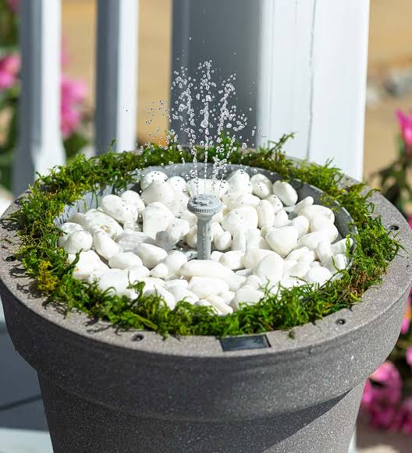
PROBLEM STATEMENT
Constant evaporation and splashes from the fountain will reduce the water level, and in a long run the water in the fountain reservoir will dry off, therefore we need a system that can constantly monitor the water level. During day-to-day activities many people often forget to water their plants and thus it becomes challenging for them to keep their plants healthy and alive. Also, it is a challenge for farmers to
maintain their fields and manage watering of plants during
shortage of water.

Slide 4
METHODOLOGY
1.
HARDWARE SELECTION
SENSOR INTEGRATION
2.
MOTOR CONTROL
INTERNET CONNECTIVITY
3.
PROGRAMMING
IoT PLATFORM SELECTION
4.
DATA TRANSMISSION
CLOUD CONFIGURATION
5.
USER INTERFACE
AUTOMATION
6.
DATA ANALYTICS
SAFETY MEASURES

Slide 5
HARDWARES
1.Fountain Hardware: Start with a basic water fountain or build your own using a pump, tubing, and a water container.
2.Iot Device: Need a microcontroller (e. g., Raspberry Pi, Arduino, or, ESP8266/ESP32)to control the fountain and connect it to the internet.
3.Water level sensor: Use a water level sensor to monitor the water level in the fountain.
4.Control mechanism: Implement a motor control or valve system to adjust the water flow.
5.sensors: Optional sensors like temperature and humidity sensors for environment monitoring.
6.Power supply: Ensure a stable power supply for the IoT device and the fountain components.
7.Internet connectivity: Choose a method for internet connectivity (Wi-fi, Ethernet, or cellular)for your IoT device.

Slide 6
8.LED: LED light is connected to appropriate digital pins on your microcontroller and also connect the current –limiting resistors in series with the LEDs.
9.Water Pump: Connect the positive wire(usually red)from the water pump to a digital pin on your microcontroller(e.g., pin9)and the negative wire(usually black or brown)to the microcontroller’s ground (GND).
10.Tubing: Set up the tubing to ensure water flows from the pump to the desired locations in your fountain.

Slide 7
FUNCTIONALITY
1.Remote Control: Allow users to control the fountain through a mobile app or web interface.
2.Automated Features: Implement automation features like scheduling, water level alerts, or adjusting water flow based on environmental conditions.
3.Data Analytics: Analyze the collected data for insights into water usage and environmental conditions.
4.Safety: Include safety features like automatic shut-off if the water level is too low.
5.Energy Efficiency: Optimize your system for energy efficiency, especially if it’s running 24/7.

Slide 8
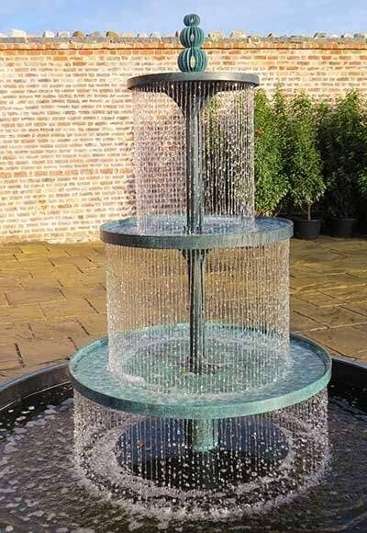
Problem solution
The project is to design a smart water fountain that can monitor the water quality and automatically replace water polluted(not healthy)or running out. We will use sensors to measure the water quality. common water quality measurement factors include temperature, PH-value, conductance, turbidity and hardness. Considering the pollution at home can only affect limited factors, we choose temperature, PH-value and conductance to be the three properties used for calculating water quality in our water fountain. the water Fountain is also designed to self –filter the water every time when water is pumped through the submersible water pump.

Slide 9
conclusion

Slide 10
THANK YOU

